Slide 1
HTTP & APIs

Slide 2
AGENDA
Web Server vs Web Client
Client/Server Model
TCP/IP Suite of Protocols
HTTP Fundamentals
DNS Service
Request / Response
200 vs 404 vs 500 (Common status codes)
API endpoints
Query string params
JSON
Simple node HTTP Client example (live coding exercise)

Slide 3
1. Web Server vs Web Client

Slide 4
1. Web Server vs Web Client

Slide 5
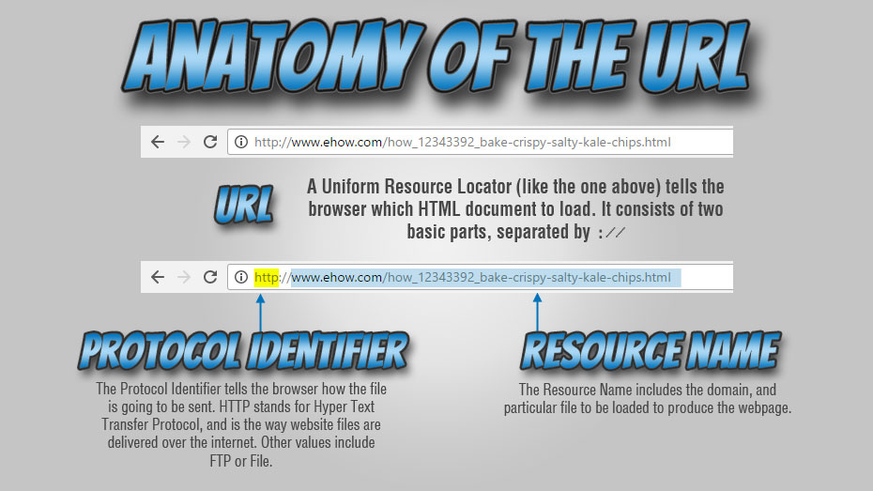
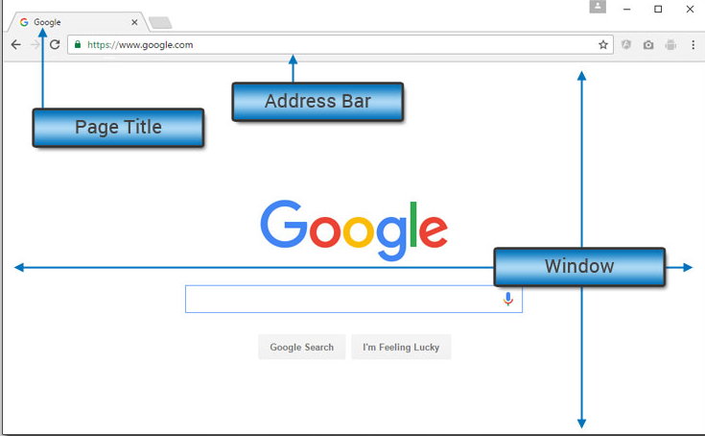

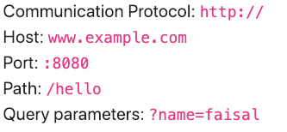
1. Web Server vs Web Client

Slide 6
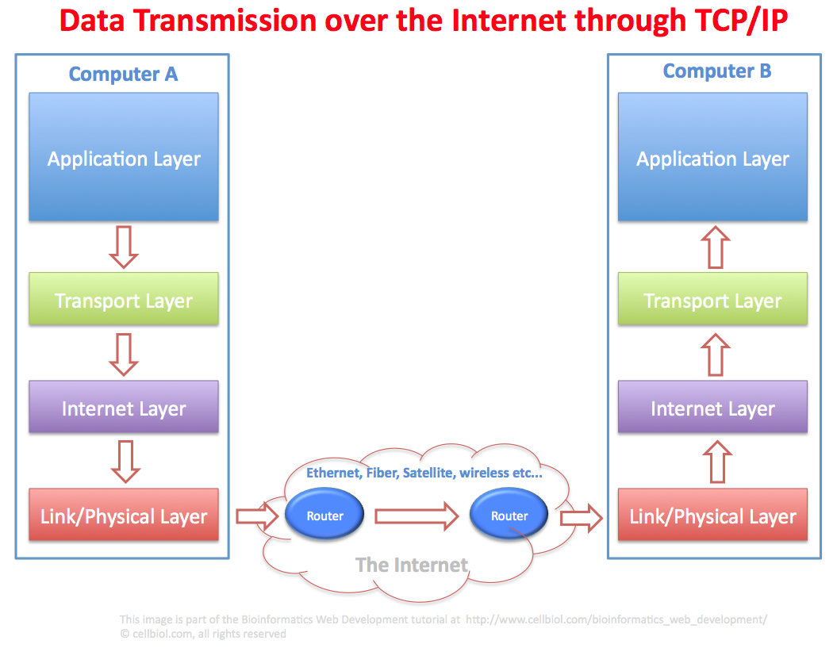
1. Web Server vs Web Client
TCP/IP suite of Protocols

Slide 7
2. HTTP Fundamentals

Slide 8
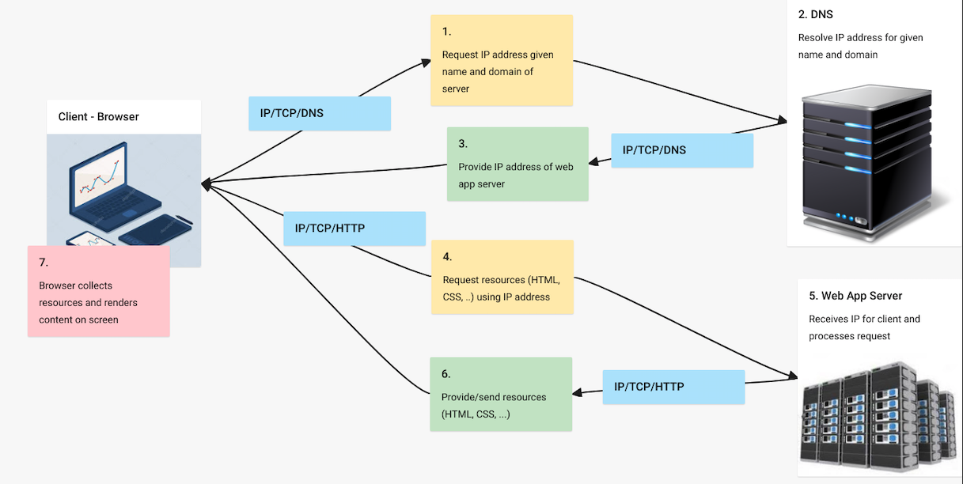
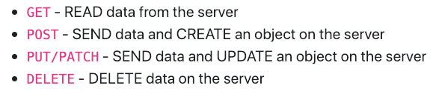

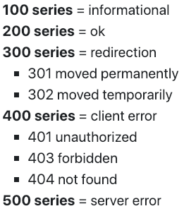
2. HTTP Fundamentals

Slide 9

Request / Response
1. Request
Server
GET /about/ HTTP/1.1 Host: example.com
2. Response
Server
HTTP/1.1 200 OK Date: Tue, 17 Dec 2013 00:00:00 GMT Server: Apache
Content-Type: text/html; charset=UTF-8
<html>
...
</html>

Slide 10
HTTP Methods / Verbs
GET * (READ) | Request data from a server. Data could be html, images, video, etc.
POST * (CREATE) | Send data from the browser to the server. Ex. registration form
PUT & PATCH (UPDATE) | Send data from the browser to the server. Used to update a resource. (ex. update your user profile on a site)
DELETE (DELETE) | Deletes a resource. (ex. delete an email in Gmail)
http://en.wikipedia.org/wiki/Hypertext_Transfer_Protocol#Request_methods

Slide 11
HTTP Responses
200 | OK: The request was successful.
204 | No Content: The request was successful. No need to return any content in the response.
301 | Moved Permanently: This and all future requests should be redirected to another URL.
304 | Not Modified: Your browser already has this content. Server will not send the content again. (Caching)
403 | Forbidden: You are not allowed to access the page.
404 | Not found: Requested resource could not be found.
500 | Internal Server Error: The server code crashed.

Slide 12
API Endpoints

Slide 13
Parameters
Sent by the browser as arguments to the server
As part of the URL (visible)
Example: /movies/search?q=ring&category=drama
As part of the message body (hidden)
Example: username=johndoe&password=mmmbeer
GET only has URL parameters

